Slide 1
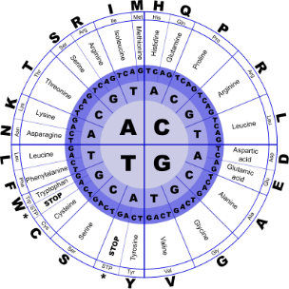
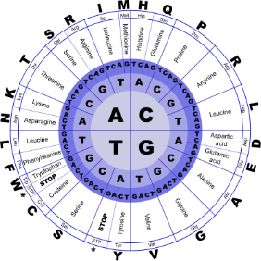


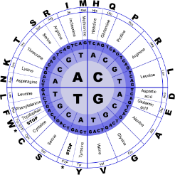
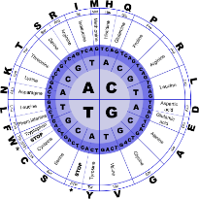
Fundamentals of Programming II
Basics

Slide 2
Data Type Conversion
Operations are performed between operands of the same type
If operands do not have the same type, C++ will automatically convert one to be the type of the other
This can impact the results of calculations

Slide 3
Hierarchy of Data Types
Highest
Ranked by largest number they can hold
Lowest
long double
double
float
unsigned long
long
unsigned int
int

Slide 4
Type Coercion
Coercion
Promotion
Demotion:
automatic conversion of an operand to another data type
converts to a higher type
onverts to a lower type

Slide 5
Type Casting
Used for manual data type conversion
Format
static_cast<Data Type>(Value)
Example:
cout << static_cast<int>(4.2);
// Displays 4

Slide 6
Type Casting
char ch = 'C';
cout << ch << " is stored as "
<< static_cast<int>(ch);
gallons = static_cast<int>(area/500);
avg = static_cast<double>(sum)/count;

Slide 7
Overflow Example
// Create a short int initialized to
// the largest value it can hold
short int num = 32767;
cout << num; // Displays 32767
num = num + 1;
cout << num; // Displays -32768

Slide 8
Handling Overflow and Underflow
Different systems handle the problem differently. They may
display a warning / error message, or display a dialog box and ask what to do
stop the program
continue execution with the incorrect value

Slide 9
const vs. #define
no ; goes here
#define
C-style of naming constants
#define NUM_STATES 50
Interpreted by pre-processor rather than compiler
Does not occupy a memory location like a constant variable defined with const
Instead, causes a text substitution to occur. In above example, every occurrence in program of NUM_STATES will be replaced by 50

Slide 10
Multiple and Combined Assignment
The assignment operator (=) can be used multiple times in an expression
x = y = z = 5;
Associates right to left
x = (y = (z = 5));
Done Done Done
3rd 2nd 1st

Slide 11
Multiple and Combined Assignment
Applies an arithmetic operation to a variable and assigns the result as the new value of that variable
Operators: += -= *= /= %=
Also called compound operators or arithmetic assignment operators
Example:
sum += amt; is short for sum = sum + amt;

Slide 12
Multiple and Combined Assignment
x += 5; means x = x + 5;
x -= 5; means x = x – 5;
x *= 5; means x = x * 5;
x /= 5; means x = x / 5;
x %= 5; means x = x % 5;
The right hand side is evaluated before the
combined assignment operation is done.
x *= a + b; means x = x * (a + b);

Slide 13
Formatting Output
Can control how output displays for numeric and string data
size
position
number of digits
Requires iomanip header file
Used to control features of an output field
Some affect just the next value displayed
setw(x): Print in a field at least x spaces wide. It will use more spaces if specified field width is not big enough.

Slide 14
Stream Manipulators
Some affect values until changed again
fixed: Use decimal notation (not E-notation) for floating-point values.
setprecision(x):
When used with fixed, print floating-point value using x digits after the decimal.
Without fixed, print floating-point value using x significant digits.
showpoint: Always print decimal for floating-point values.
left, right: left-, right justification of value

Slide 15
Stream Manipulators
const float e = 2.718;
float price = 18.0; Displays
cout << setw(8) << e << endl; ^^^2.718
cout << left << setw(8) << e << endl; 2.718^^^
cout << setprecision(2);
cout << e << endl; 2.7
cout << fixed << e << endl; 2.72
cout << setw(6) << price; ^18.00

Slide 16
Characters and Strings
char: holds a single character
string: holds a sequence of characters
Both can be used in assignment statements
Both can be displayed with cout and <<

Slide 17
String Input
Reading in a string object
string str;
cin >> str; // Reads in a string
// with no blanks
getline(cin, str); // Reads in a string
// that may contain blanks

Slide 18
Character Input
Reading in a character:
char ch;
cin >> ch; // Reads in any non-blank char
cin.get(ch); // Reads in any char
ch = cin.get;// Reads in any char
cin.ignore();// Skips over next char in the input buffer

Slide 19
String Operators
= Assigns a value to a string
string words;
words = "Tasty ";
+ Joins two strings together
string s1 = "hot", s2 = "dog";
string food = s1 + s2; // food = "hotdog"
+= Concatenates a string onto the end of another one
words += food; // words now = "Tasty hotdog"

Slide 20
string Member Functions
length() – the number of characters in a string
string firstPrez="George Washington";
int size=firstPrez.length(); // size is 17
assign() – put repeated characters in a string. Can be used for formatting output.
string equals;
equals.assign(80,'=');
…
cout << equals << endl;
cout << "Total: " << total << endl;

Slide 21
Using C-Strings
C-string is stored as an array of characters
Programmer must indicate maximum number of characters at definition
const int SIZE = 5;
char temp[SIZE] = "Hot";
NULL character (\0) is placed after final character to mark the end of the string
Programmer must make sure array is big enough for desired use; temp can hold up to 4 characters plus the \0.
H o t \0

Slide 22
C-String Input
Reading in a C-string
const int SIZE = 10;
char Cstr[SIZE];
cin >> Cstr; // Reads in a C-string with no blanks.
// Will write past the end of the array
// if input string is too long.
cin.getline(Cstr, 10);
// Reads in a C-string that may
// contain blanks. Ensures that <= 9
// chars are read in.
Can also use setw() and width() to control input field widths

Slide 23
C-String Initialization vs. Assignment
A C-string can be initialized at the time of its creation, just like a string object
const int SIZE = 10;
char month[SIZE] = "April";
However, a C-string cannot later be assigned a value using the = operator; you must use the strcpy() function
char month[SIZE];
month = "August" // wrong!
strcpy(month, "August"); //correct

Slide 24
C-String and Keyboard Input
Must use cin.getline()to put keyboard input into a C-string
Note that cin.getline() ≠ getline()
Must indicate the target C-string and maximum number of characters to read:
const int SIZE = 25;
char name[SIZE];
cout << "What's your name? ";
cin.getline(name, SIZE);

Slide 25
Mathematical Library Functions
These require cmath header file
Take double arguments and return a double
Commonly used functions
abs | Absolute value
sin | Sine
cos | Cosine
tan | Tangent
sqrt | Square root
log | Natural (e) log
pow | Raise to a power

Slide 26
Mathematical Library Functions
These require cstdlib header file
rand
Returns a random number between 0 and the largest int the computer holds
Will yield the same sequence of numbers each time the program is run
srand(x)
Initializes random number generator with
unsigned int x. x is the “seed value”.
Should be called at most once in a program

Slide 27
Random Numbers
Use time() to generate different seed values each time that a program runs:
#include <ctime> //needed for time()
…
unsigned seed = time(0);
srand(seed);
Random numbers can be scaled to a range:
int max=6;
int num;
num = rand() % max + 1;

